Slide 1
Ray Turner: Ecologist extraordinaire and a most wonderful man
Lifetime Award of the Nueva Generación de Investigadores del Desierto Sonorense
Next Generation of Sonoran Desert Researchers
Guaymas Sonora, October, 2015
N-Gen
Photo of
Award

Slide 2
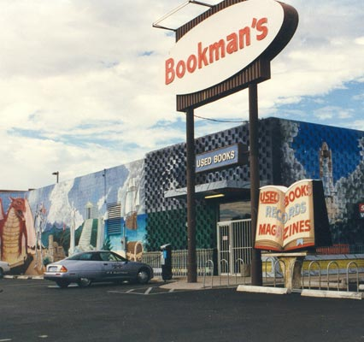
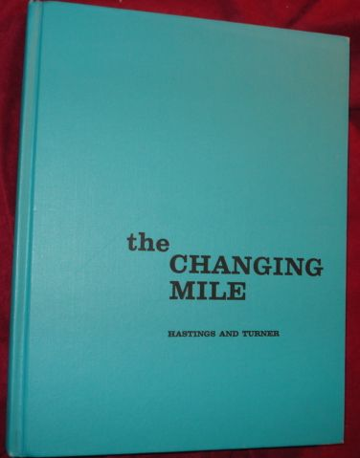
I remember going through the bookshelves of the old Bookmans store in Tucson and finding a wonderful volume bound in green with a great title: The Changing Mile: an ecological study of vegetation change with time in the lower mile of an arid and semiarid region.
It was 1974. The book, already nine years old, portrayed the history of the arid southwestern USA and northwestern Mexico using a new tool for vegetation studies; repeat photography. By comparing old, historic photographs with new stock shot on purpose by carefully matching the old photographs, Hastings and Turner were able to document the change in vegetation through time. I was marveled by the photographic pairs—some in places I had visited—and by the description of change.
That was my first exposure to Ray Turner’s extraordinary work. Little I imagined that later I would be able to chat, know, and travel with this brilliant scientist and wonderful man.

Slide 3
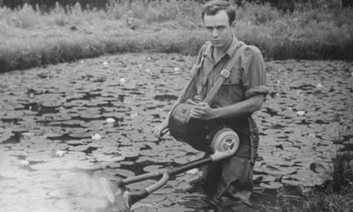
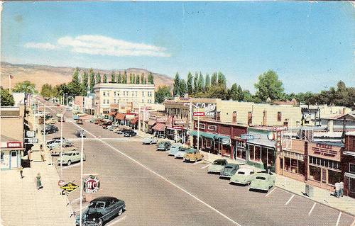
Raymond M. Turner was born in Salt Lake City, Utah, in 1927. He was 17 when he joined the U. S. Forest Service as field assistant during the summer of 1944. He worked again during 1945 and 1946 when studying at the Utah State University, and later at the University of Utah, where he got is Bachelor degree in Botany in 1948.
He worked again for the U. S. Forest Service during the summer of 1949 the year in which he married a sweetie named Jeanne Brunner the brand new Head Nurse of Sevier Valley Hospital in Richfield, Utah. After marrying, they moved to Pullman, to start his PhD in Plant Ecology at the Washington State University.

Slide 4
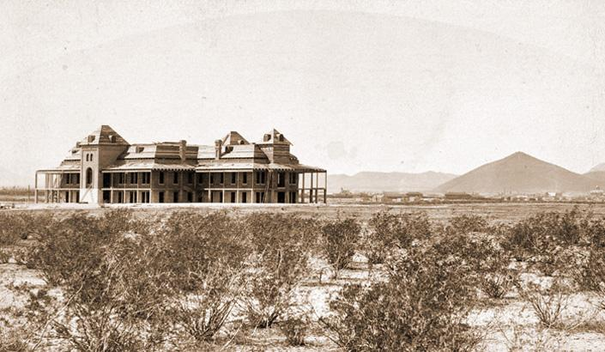
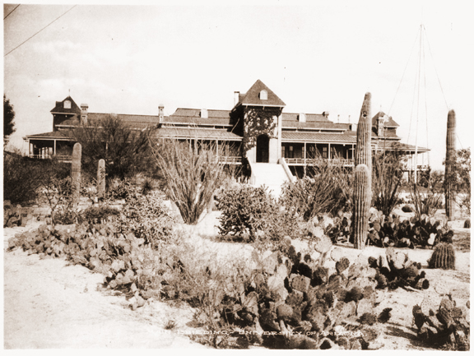
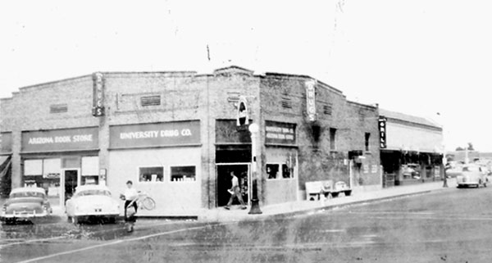
By 1954, he produced a PhD dissertation and was fast increasing his gene contribution to new generations: Jeannie and Ray had already two children and one more was on the way. They moved to Tucson where Ray had a post at the University of Arizona.
Ray worked from 1954 to 1962 at the UA, and from 1962 until his retirement in 1989 at the USGS. He is now Emeritus Professor at the Department of Geosciences, University of Arizona.

Slide 5
From the time of his defense to this very day he has produced scores of insightful papers that range from plant identification keys, to vegetation dynamics, to population ecology studies. His contributions always include colleagues from different disciplines and backgrounds.
Ray is a scientist widely loved and respected by everyone. Bob Marley said that The greatness of a man is not in how much wealth he acquires, but in his integrity and his ability to affect those around him positively—he was for sure thinking in Ray when making that assertion!
Although he is among the highest ranking desert scientists, he is brightly humble, and a generous and kind person.
When a colleague of him was fired for leading protests against the installation of the Titan Missile sites that ultimately encircled Tucson and brought huge peril to the city, Ray, in protest, resigned from the University. A high ranking university officer helped him get set up at the United States Geological Survey where he worked until his retirement.
Paul Martin, referred to Ray as a "scientific saint"

Slide 6
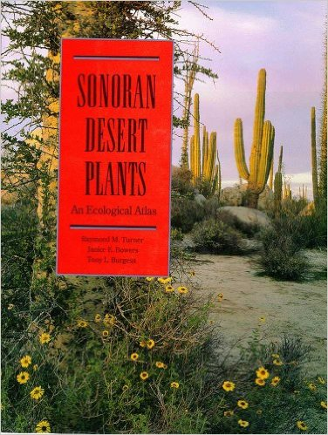
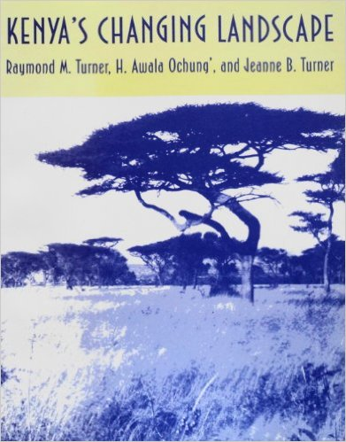
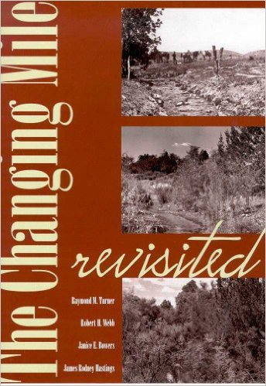
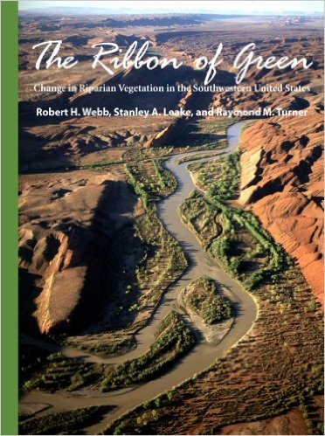
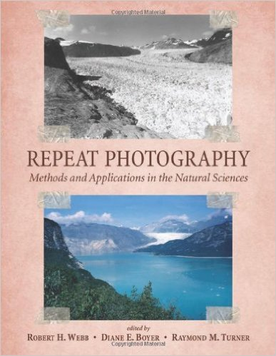
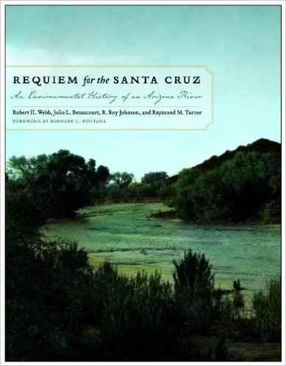
After his retirement, he worked in summarizing the work of a lifetime giving us many innovative and amazing books and new research papers. The books included: Sonoran Desert Plants: An Ecological Atlas,(1995), Kenya's Changing Landscape (1998),
The Changing Mile Revisited (2003)—a revised edition of The Changing Mile (1965), The Ribbon of Green: Change in Riparian Vegetation in the Southwestern United States (2007),
Repeat Photography: Methods and Applications in the Natural Sciences (2010), and recently, Requiem for the Santa Cruz: An Environmental History of an Arizona River (2014

Slide 7
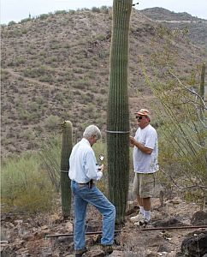
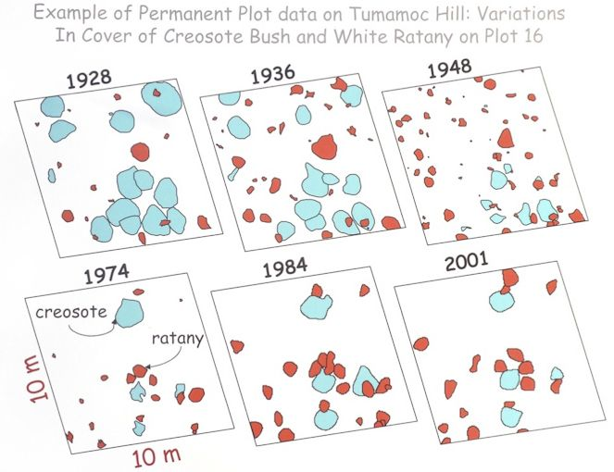
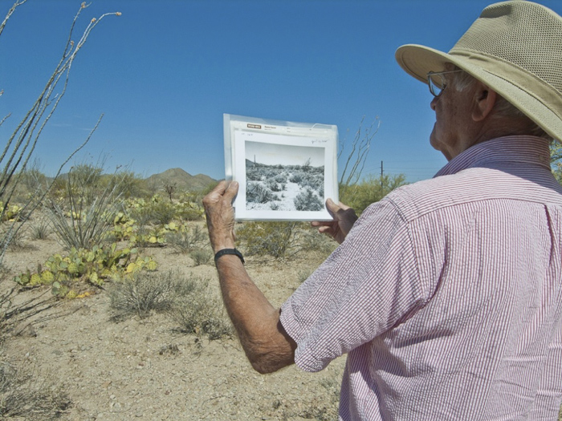
Looking back in time, Ray’s main interest lies in understanding the deep time of vegetation dynamics, not what happens from year to year, but the usually lethargic although not always lazy change in natural landscapes, and the slow, but sometimes not gentle change in the population numbers of plants through time. A time extending farther than the lifespan of the population elders. His interest in desert vegetation dynamics, and his perseverance and painstaking work maintained and assembled the longest record of vegetation dynamics by studying long-term permanent study plots at Tumamoc Hill; plots that were originally established by the pioneer ecologists at the hill during the early 1900s.

Slide 8
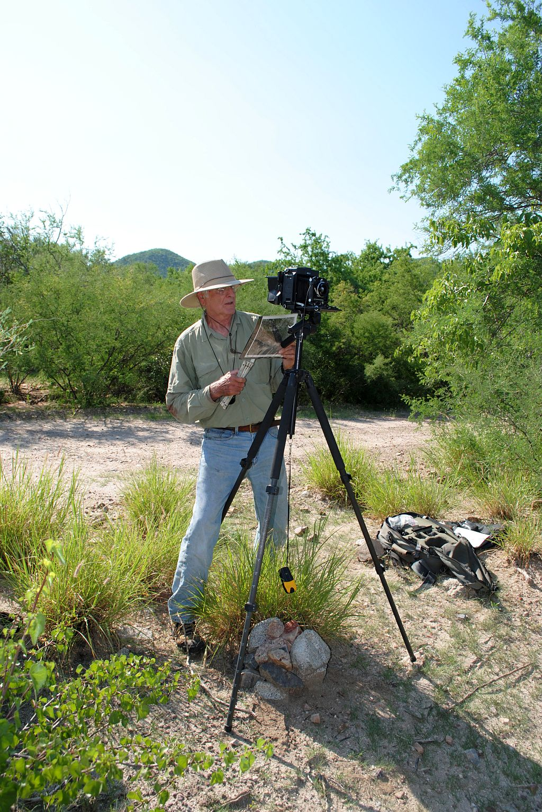
With the help of students and colleagues, he also documented the change in population dynamics of saguaro inside MacDougal crater in the Pinacate volcanic shield in a seminal paper published in Ecology and kept monitoring the saguaros originally plotted in 1908-1910 by the scientific staff at the Desert Laboratory in Tumamoc Hill where he also documented the flora, started mapping the arrival of exotic plants, measured the phenology and population ecology of several desert trees including foothill and blue palo verdes, mesquites, and the iconic saguaro population dynamics.

Slide 9
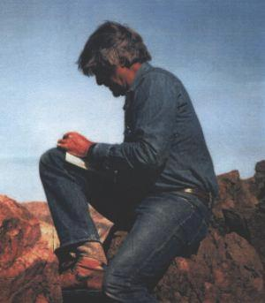
The N-Gen membership is honored to include Ray in the first edition of the Lifetime Achievement Award. It is a great honor to for me to handle this award on behalf of the Board and membership of the N-Gen of Sonoran Desert Researchers not only for a lifetime of extraordinaire academic work and contributions, but also for his dedication to archiving data and photographs, and for his amazing kindness and humanity to Dr. Raymond Marriner Turner.

